Slide 1
CSS342 Data Structures, Algorithms, and Discrete Mathematics (I)

Slide 2
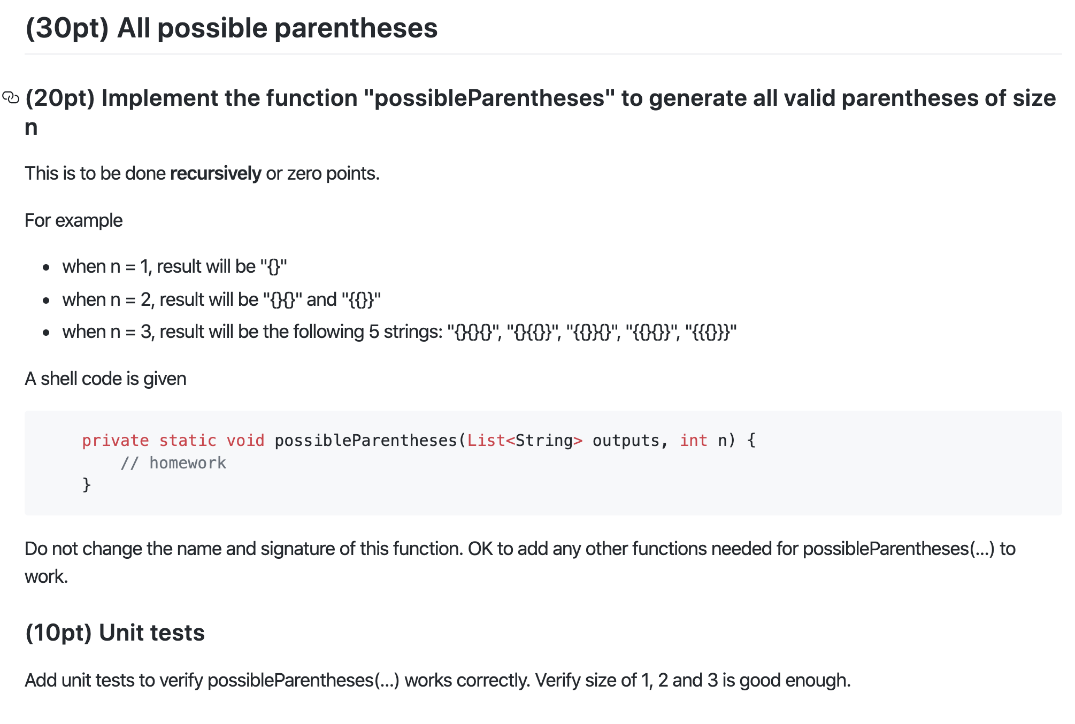
Homework 4

Slide 3
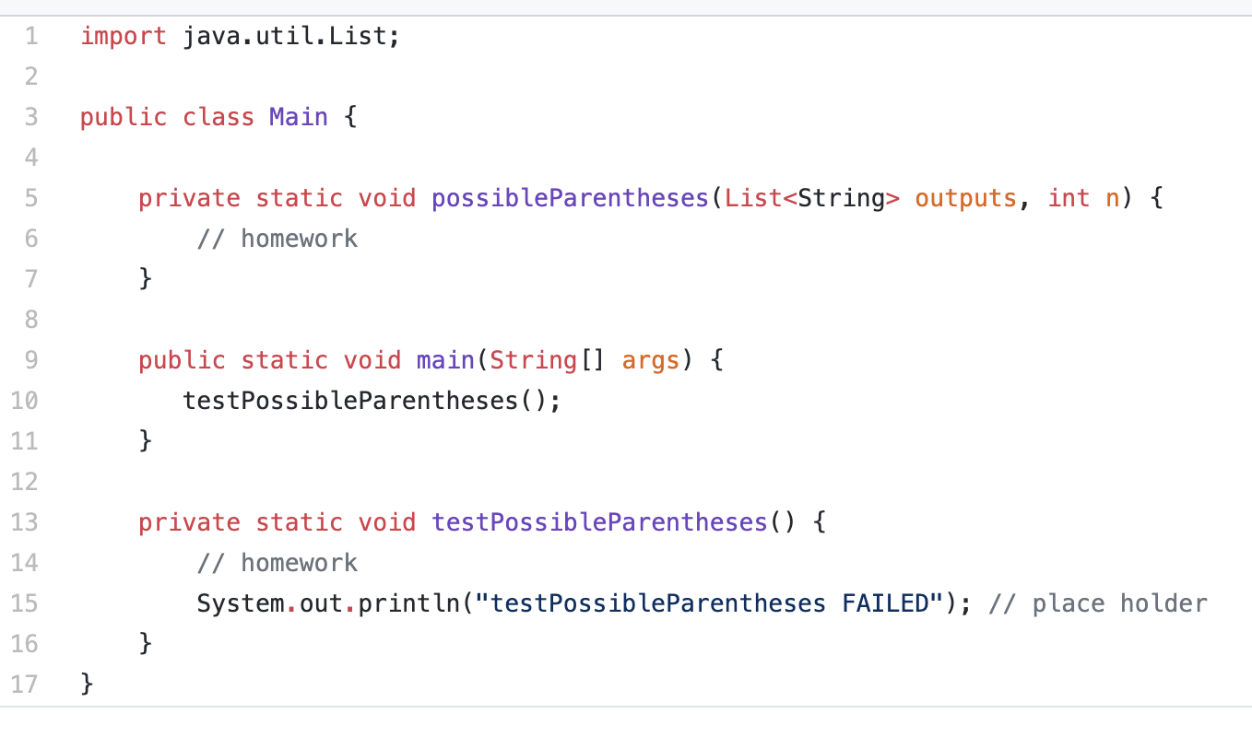
Homework 4

Slide 4
Homework 4
N=2 → outputs={“{{}}”, “{}{}”}

Slide 5
Binary Search Tree
A Binary Search Tree (BST) is a tree in which all the nodes follow the below-mentioned properties:
The left sub-tree of a node has a key less than or equal to its parent node's key.
The right sub-tree of a node has a key greater than to its parent node's key.

Slide 6
Exercise
Is this a binary search tree?
8
3
10
14
1
6
4
7

Slide 7
Exercise
Is this a binary search tree?
8
3
10
11
14
1
6
4
7

Slide 8
Exercise
Is this a binary search tree?
8
3
1
6
4
7

Slide 9
Exercise
Is this a binary search tree?
2
3
5
7
6
9

Slide 10
Tree Node
Implementation
Data storage:
Array
List
3
1
5
7
Left
Right
Next

Slide 11
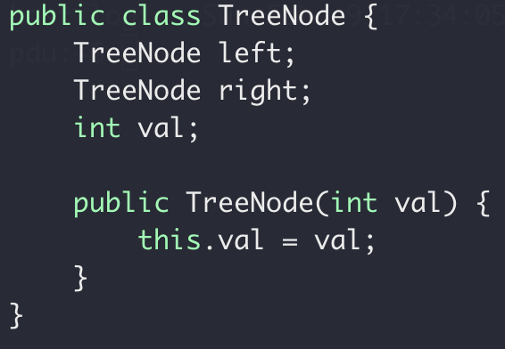
Tree Node
Implementation
Data storage:
Array
List
TreeNode
Left
Right

Slide 12
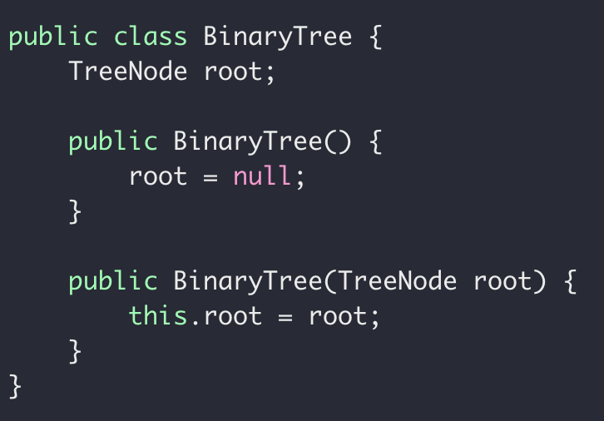
Tree ADT
Implementation
Data storage:
Array
List

Slide 13
Tree Traversal
Visit each node of a tree
1
1
2
2
7

Slide 14
Binary Tree Traversal
Pre-order: root, left, right
3
1
1
5
2
7
2
7
8
1, 2, 7
3, 1, 2, 7, 5, 8

Slide 15
Exercise
What’s the pre-order traversal of this tree?
8
3
10
9
14
1
6
4
7

Slide 16
Code it up!
preorder: Root, Left, Right
Recursion
Middle node value
preorder(left subtree)
Preorder(right subtree)
Subproblem?
Stopping condition?
Node == null

Slide 17
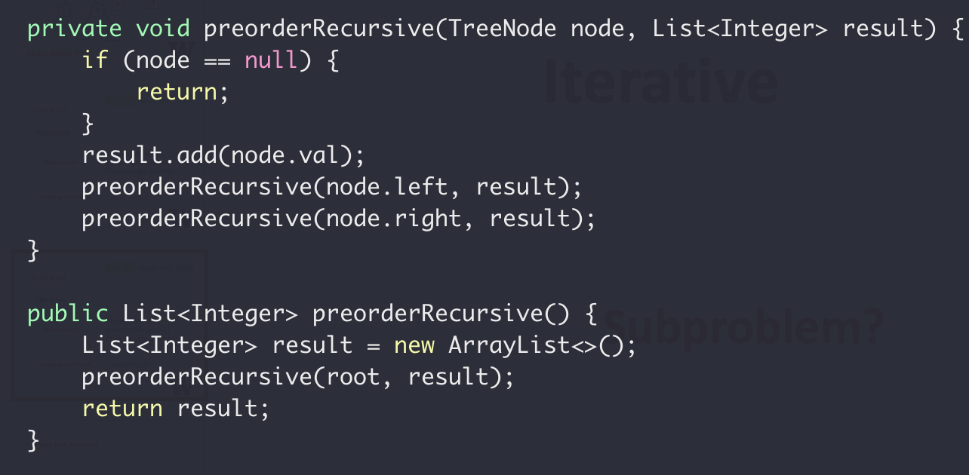
preorder: Root, Left, Right
Recursion

Slide 18
preorder: Root, Left, Right
Iterative
(without recursion)
3
2
4
Result (List):
3
2
4
Stack:
4
2

Slide 19
preorder: Root, Left, Right
Iterative
(without recursion)
While stack not empty {
3
Pop a node from Stack
Add middle node to result list
2
4
Push right node to Stack if any
Push left node to Stack if any
}

Slide 20
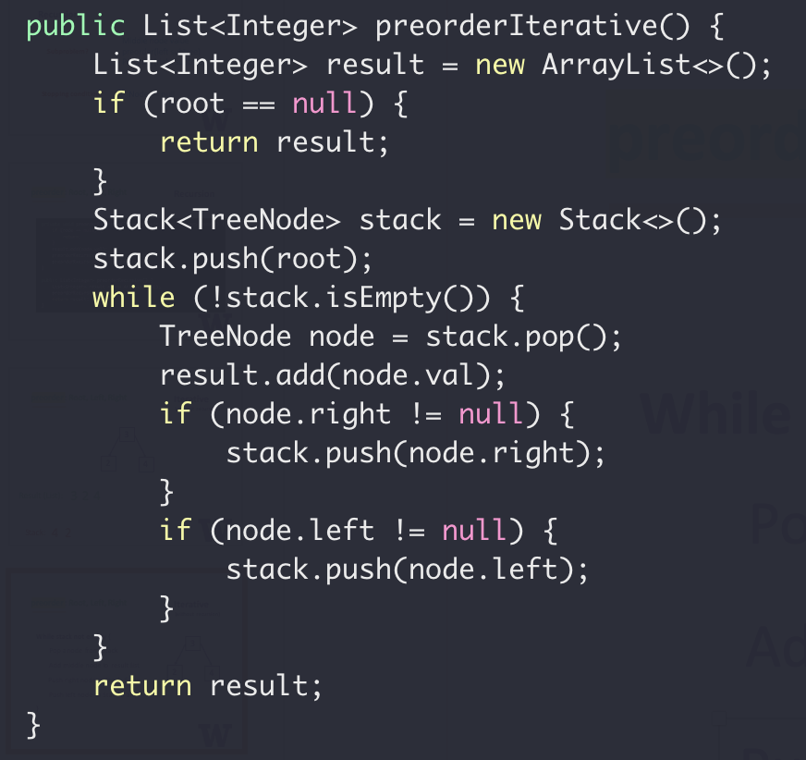
preorder: Root, Left, Right
Iterative
(without recursion)
While stack not empty {
Pop a node from Stack
Add middle node to result list
Push right node to Stack if any
Push left node to Stack if any
}

Slide 21
Pre-order Application
Target: 14
Search in a BST
?
9
9
?
3
12
1
5
10
14
?
14
7
12
18
Top down
Preorder

Slide 22
Binary Tree Traversal
In-order: left, root, right
3
1
1
5
2
7
2
7
8
2, 1, 7
2, 1, 7, 3, 8, 5

Slide 23
Exercise
What’s the inorder traversal of this tree?
8
3
10
9
14
1
6
4
7
In: 1, 3, 4, 7, 6, 8, 9, 10, 14
In: 1, 3, 4, 6, 7, 8, 9, 10, 14

Slide 24
Code it up!
inorder: Left, Root, Right
Recursion
Inorder(left subtree)
Middle node value
Inorder(right subtree)
Subproblem?
Stopping condition?
Node == null

Slide 25
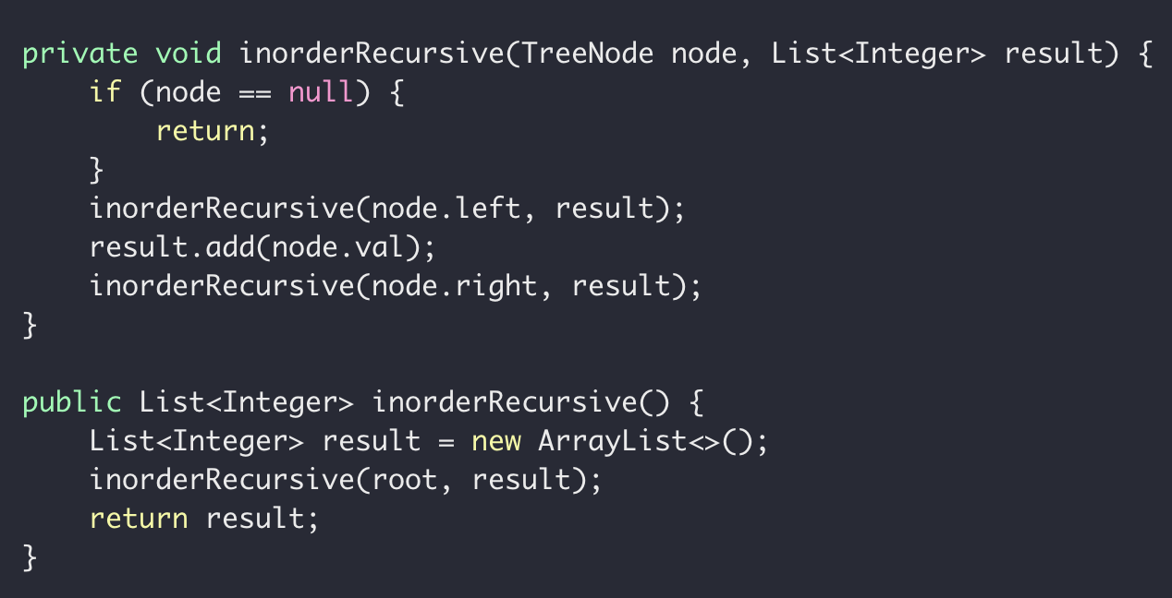
inorder: Left, Root, Right
Recursion

Slide 26
Binary Tree Traversal
Post-order: left, right, root
3
1
1
5
2
7
2
7
8
2, 7, 1
2, 7, 1, 8, 5, 3

Slide 27
Exercise
What’s the postorder traversal of this tree?
8
3
10
2
14
1
6
4
7

Slide 28
Code it up!
postorder: Left, Right, Root
Recursion
Inorder(left subtree)
Inorder(right subtree)
Middle node value
Subproblem?
Stopping condition?
Node == null

Slide 29
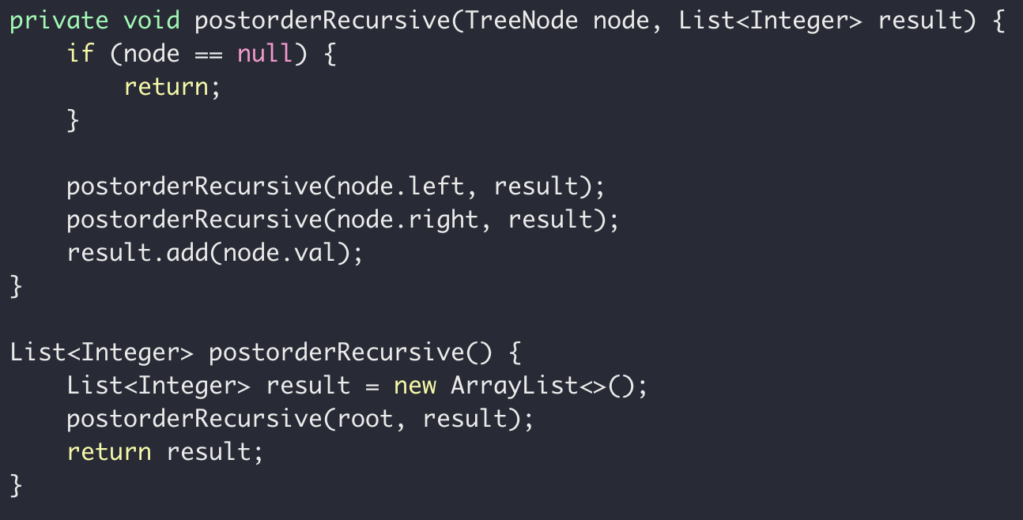
postorder: Root, Left, Right
Recursion

Slide 30
Recursion with Trees
8
3
10
2
14
1
6
4
7

Slide 31
Binary Tree Definition
3
1
5
7
Height of a tree:
Number of nodes
on the longest path
from root to leaf
5
Height = 4
3
3
3
9
1
5
1
1
5
7
Height = 3
Height = 1
Height = 2
Height = 2

Slide 32


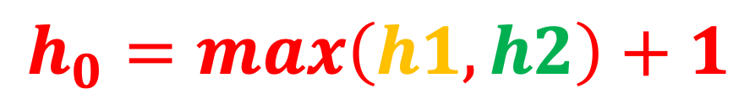


Height of a tree
$$h_{0}$$
$$h_{1}$$
$$h_{2}$$
$$h_{0}= ?$$
$$h_{0}=max\left(h1, h2\right)+1$$

Slide 33
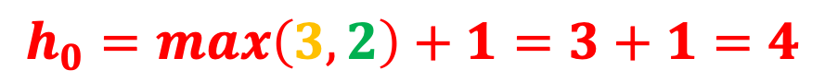

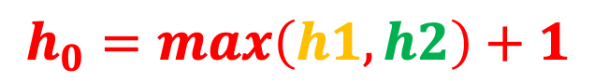





$$h_{0}=max\left(h1, h2\right)+1$$
$$h_{0}=max\left(3, 2\right)+1=3+1=4$$
$$h_{0}$$
$$4$$
8
$$h_{2}$$
$$h_{1}$$
$$2$$
$$3$$
3
10
2
14
1
6
4
7

Slide 34
Code it up!
Height of a tree
Recursion
height(left subtree)
height(right subtree)
Subproblem?
Stopping condition?
Node == null

Slide 35
Code it up!
Height of a Tree
Bottom up
Postorder
4
3
8
2
1
3
2
1
10
1
1
6
2
14
0
0
0
1
0
0
0
0
6
0
0

Slide 36
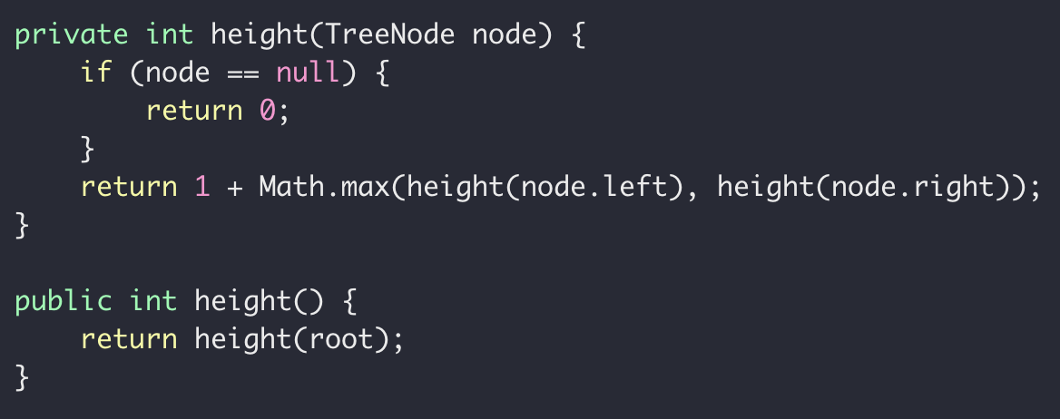
Code it up!
Height of a Tree

Slide 37
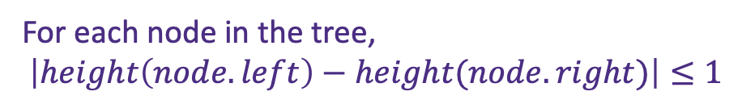
Balanced Tree
“Balanced”:
The left and right subtrees of every node differ in height by no more than 1.
For each node in the tree,
$$\left|height\left(node.left\right)−height(node.right)\right|≤1$$

Slide 38
Balanced Tree
“Balanced”:
The left and right subtrees of every node differ in height by no more than 1.
2
8
2
1
3
1
1
10
1
1
6
2
14
0
0

Slide 39
Balanced Tree
“Balanced”:
The left and right subtrees of every node differ in height by no more than 1.
2
8
1
1
3
0
10
1
0
0

Slide 40
Balanced Tree
“Balanced”:
The left and right subtrees of every node differ in height by no more than 1.
3
8
2
2
3
0
1
10
1
1
2
14
1
0
8
0
0

Slide 41
Code it up!
Balanced Tree
Balanced(left subtree)
Balanced(right subtree)
Subproblem?
Stopping condition?
Node == null

Slide 42
Example of Imbalanced Binary Search Tree
8
3
1
6
4
7

Slide 43
Example of Imbalanced Binary Search Tree
2
3
5
7
9

Slide 44
Exercise
Lowest Common Ancestor of two given nodes
Assumption: Binary Search Tree, v1, v2 always exists in the tree
r = LCA(v1, v2)
LCA(1, 4)
LCA(4, 9)
6
LCA(1, 3)
LCA(4, 7)
LCA(3, 1)
3
9
LCA(3, 9)
LCA(1, 6)
1
4
7

Slide 45
LCA of BST
6
r
LCA(3, 9)
LCA(1, 4)
3
9
v1
v1
v1
v1
LCA(10, 15)

Slide 46
Code it up!
Recursion
LCA(left subtree), or
LCA(right subtree)
Subproblem?
Stopping condition?
Node == null, or
Node.val is the LCA

Slide 47
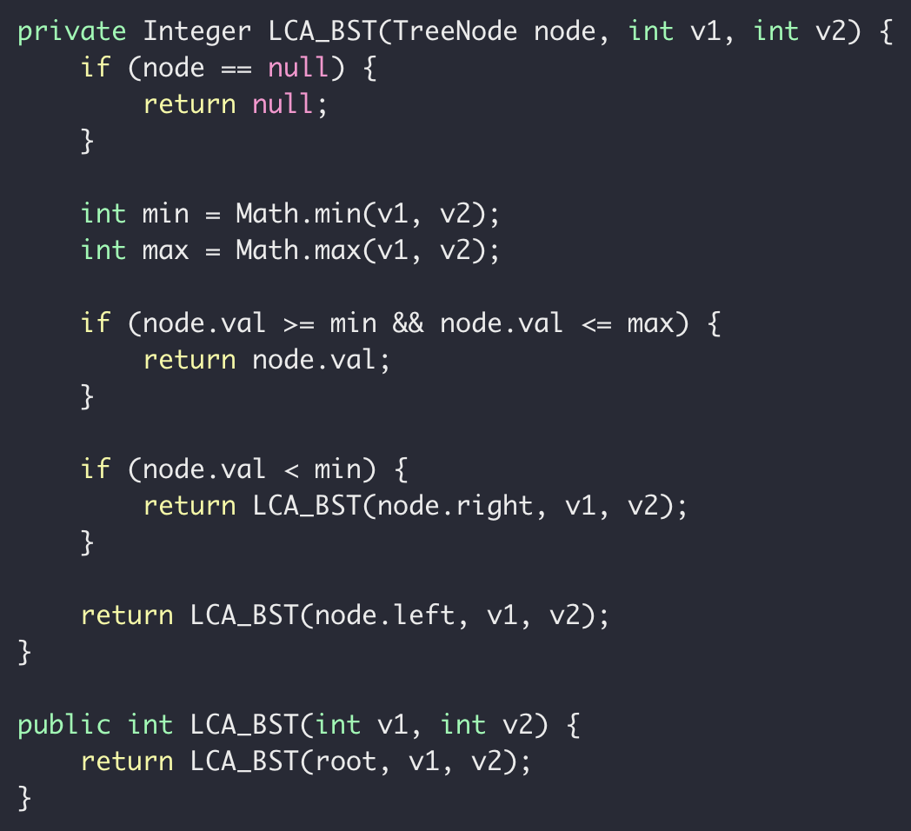
Code it up!
What if it’s not a BST?

Slide 48
Binary Tree LCA
3
LCA(2, 5)
nullptr
nullptr
nullptr
5
2
Check root, if it’s one of the numbers, return itself,

Slide 49
Binary Tree LCA
LCA(2, 5)
5?
3
2
3
9
3
2
5
Search a node in a binary tree, worse case to visit N nodes, or O(N)

Slide 50
Binary Tree LCA
2
LCA(2, 5)
Check root, if it’s one of the numbers, return itself
Check both children
If both of them has a candidate number, return root
If neither of them has a candidate number, return null
If one of them has a candidate number, return that children

Slide 51
Binary Tree LCA
3
1
5
LCA(2, 5)
2
7
8
Bottom up
LCA(2, 1)
LCA(2, 7)
LCA(7, 8)
Check root, if it’s one of the numbers, return itself
Check both children
If both of them has a candidate number, return root
If neither of them has a candidate number, return null
If one of them has a candidate number, return that children

Slide 52
Binary Tree LCA
3
1
5
LCA(2, 5)
2
7
8
Bottom up
LCA(2, 1)
LCA(2, 7)
LCA(7, 8)
Check root, if it’s one of the numbers, return itself
Check both children
If both of them has a candidate number, return root
If neither of them has a candidate number, return null
If one of them has a candidate number, return that children

Slide 53
Why are we talking about binary trees again?

Slide 54
A search problem
Target: 14
18
12
1
7
5
10
3
12
9
14
14
0
1
2
3
4
5
6
7
8
9

Slide 55

A search problem
Possible Solutions:
Linear search in a random array
Slow insertion, slow search
Sort array and then binary search
Slow insertion, slow search
Use binary search tree
fast insertion, fast search

Slide 56
A search problem
Linear search in a random array
Sort array and then binary search
Use binary search tree
search
Size n

Slide 57
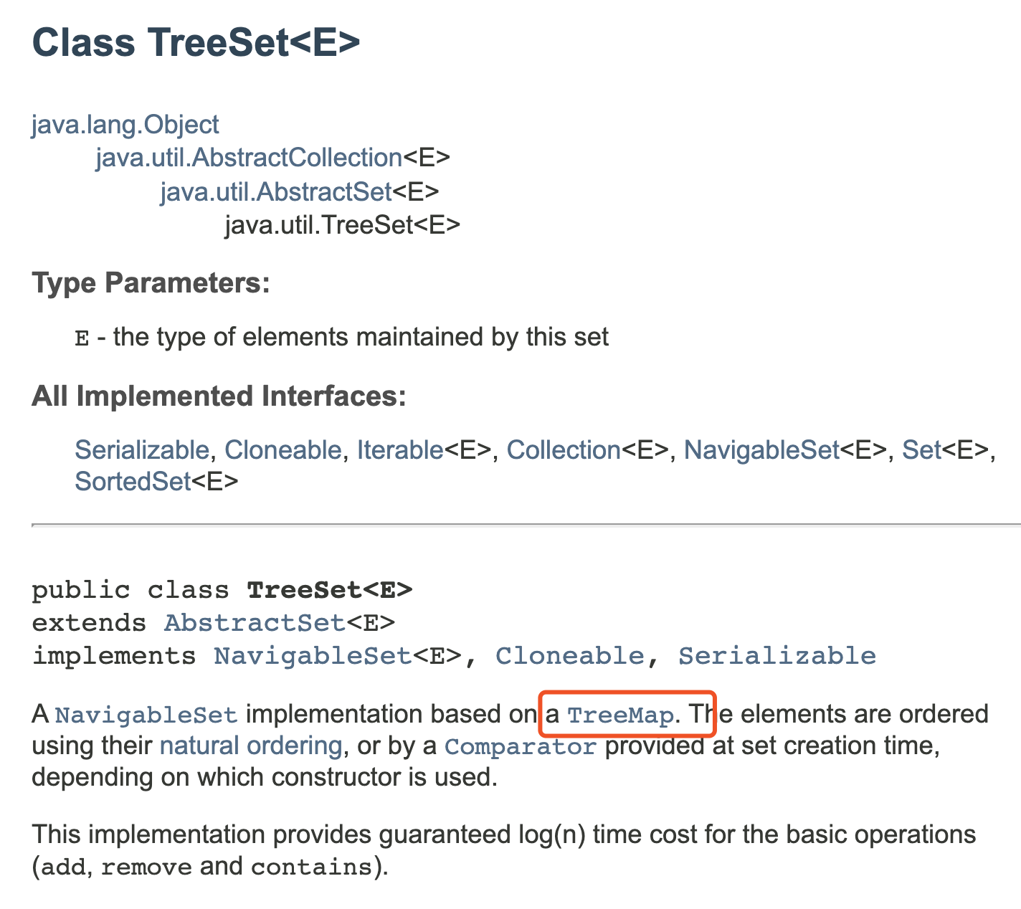
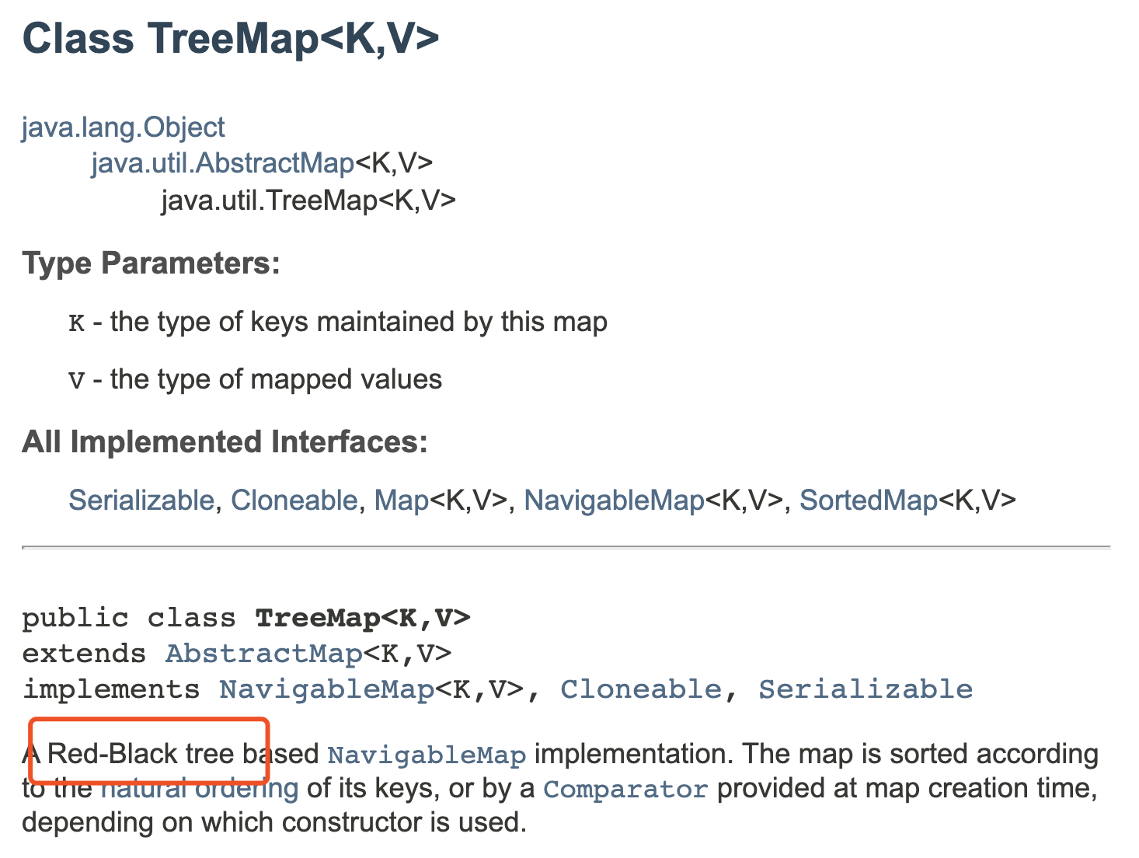
A search problem
Linear search in a random array
Sort array and then binary search
Use binary search tree

Slide 58
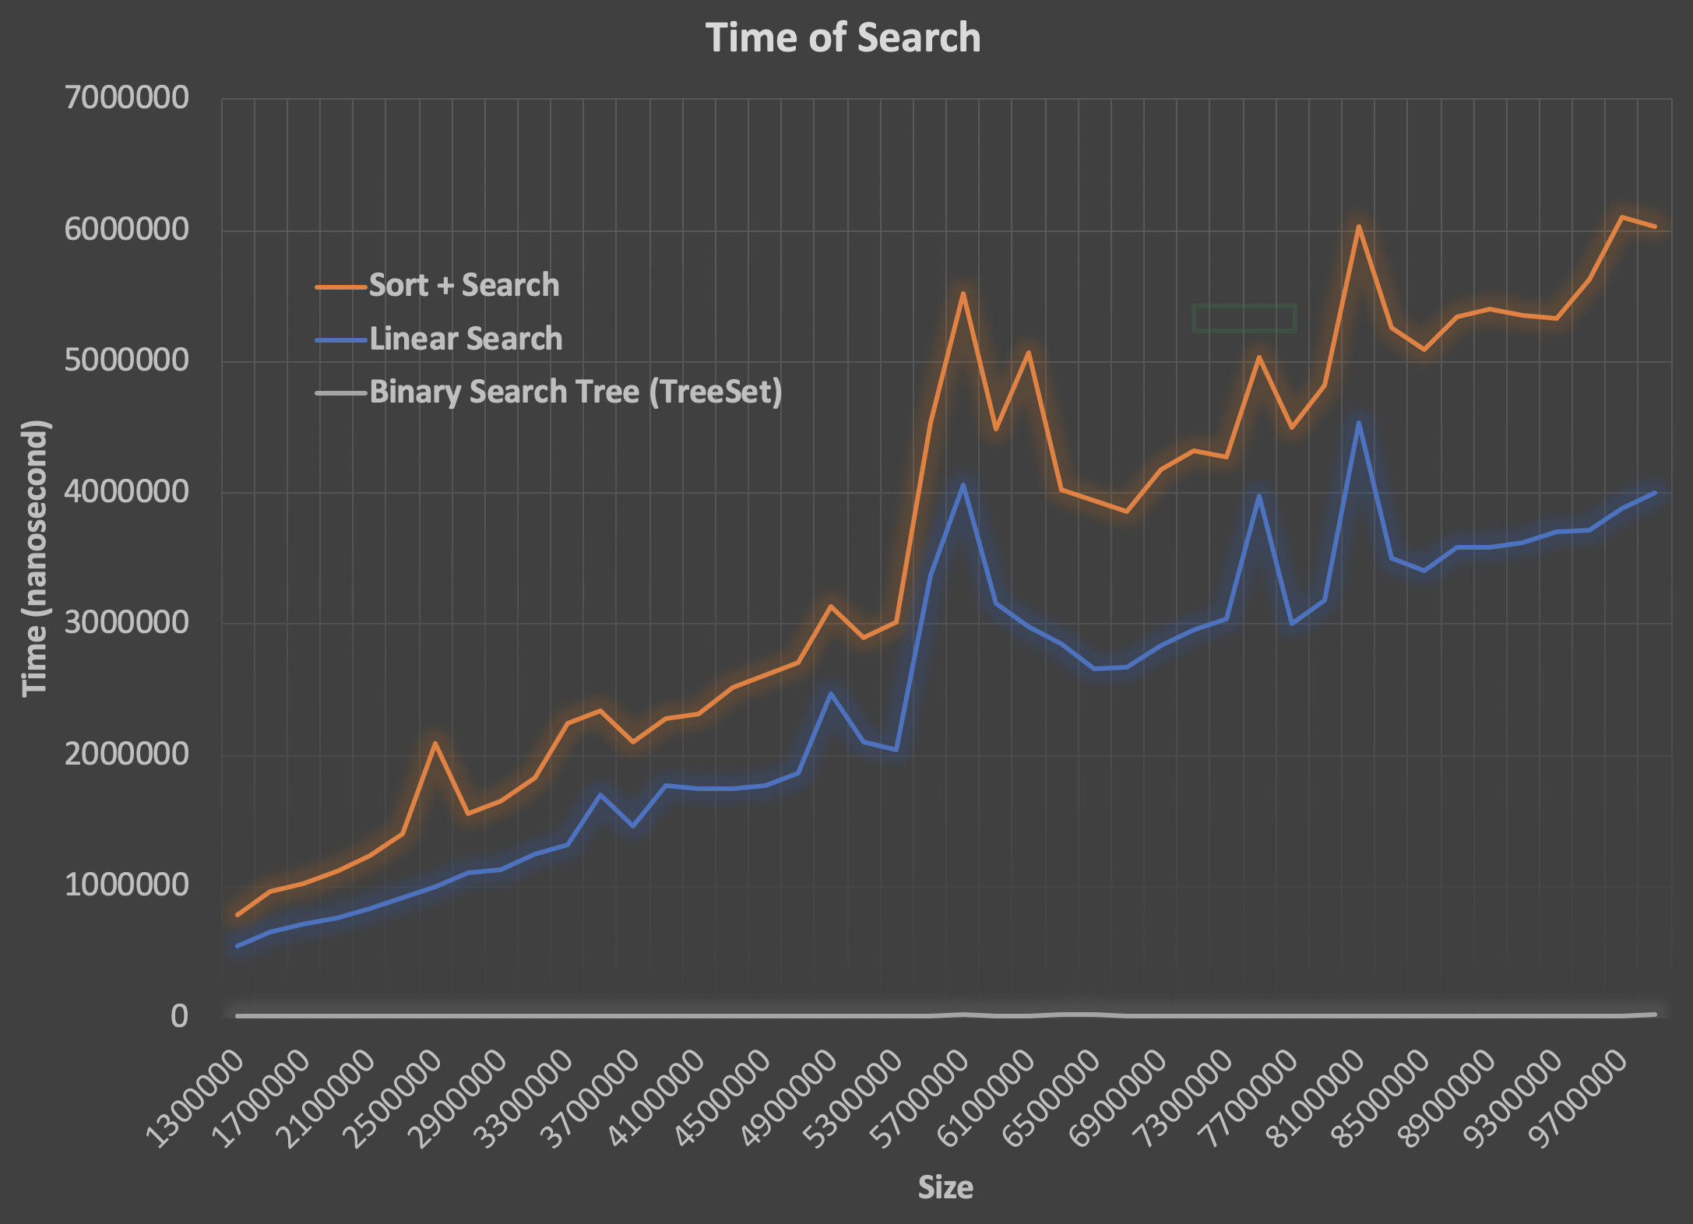
A search problem

Slide 59



A search problem
Possible Solutions:
Linear search in a random array
Slow insertion, slow search
Sort array and then binary search
Slow insertion, slow search
Use binary search tree
fast insertion, fast search

Slide 60
Tree Summary
Another ADT
Binary Tree vs Binary Search Tree
Implementation
Node with two pointer references
Array
Only for balanced tree
Heap (will be disc
used in later lecture in Sorting)
Traverse
inorder, inorder, postorder
Level order?
Application: Sorting, searching, database

